Slide 1
Committee Meeting
Minzhe Zhang
Integrative Biology Graduate Program
Mentors: Yang Xie & Guanghua Xiao
Committee Members: Dr. Joshua Mendell
Dr. Xiaowei Zhan
Dr. Deepak Nijhawan
04/19/1992

Slide 2
Outline
Computational Approach to Predict Multi-Drug Synergistic Effect
Background
IGRE model
Biological validation
Summary and future plan
Bioinformatics Tool to Detect RBP Bound CircRNA in CLIP-Seq Datasets
Background
Motivation
Pipeline
Preliminary results
Future plan

Slide 3
Outline
Computational Approach to Predict Multi-Drug Synergistic Effect
Background
DIGRE model
Biological validation
Summary and future plan
Bioinformatics Tool to Detect RBP Bound CircRNA in CLIP-Seq Datasets
Background
Motivation
Pipeline
Preliminary results
Future plan

Slide 4
What is drug synergy?
The concept of synergy is complicated
Synergy: exceed additive effect
Antagonism: below additive effect
Additive: ???
Two different assumptions on additive effect
Bliss independence model
Loewe additivity model
40%
60%
Compound A
30%
70%
Compound B
?
?
Combination
Death
Survival
Notes:
First, what is drug synergy? Drug synergy is a very complicated concept, it is usually defined as the combinatory effect exceed the additive effect of two drug.
Accordingly, antagonism as below the additive effect. But a important question to ask here is what is additive effect.
E.g. if A kill 40% of cell, B kills 30%, if no synergy occurs, what do we expect to see? How much cell should get killed.
To answer this question, we first need to define the additive effect.
There are many different assumptions on what additive effect should be, … and … are the most common two.

Slide 5
Bliss independence model
Assumption on additive: two drug elicit their effect independently
Limitation
Does not apply when a drug combined with itself
(a drug combined with itself should always be additive, but not in this model)
Dose response curve is ignored
f_{A}
40%
60%
1 – f_{A} drug A
f_{B}
30%
70%
1 – f_{B} drug B
1 - (1-f_{A})(1-f_{B})
58%
42%
(1-f_{A})(1-f_{B}) combination
Death
Survival
Notes:
Bliss assume when two drugs …, they should be additive.
E.g. 60% survive after drug A treatment, then .6 time .7, there should be 42% cell survive when we treat cell with both A and B.
This model is straightforward, and easy to calculate, but it has some limitations.
The most important one is it does not…
Intuitively, a drug combined with …,
The reason is this model ignore the dose response curve of two drug, so the calculation will violate the dose response curve when a drug combined with itself.

Slide 6
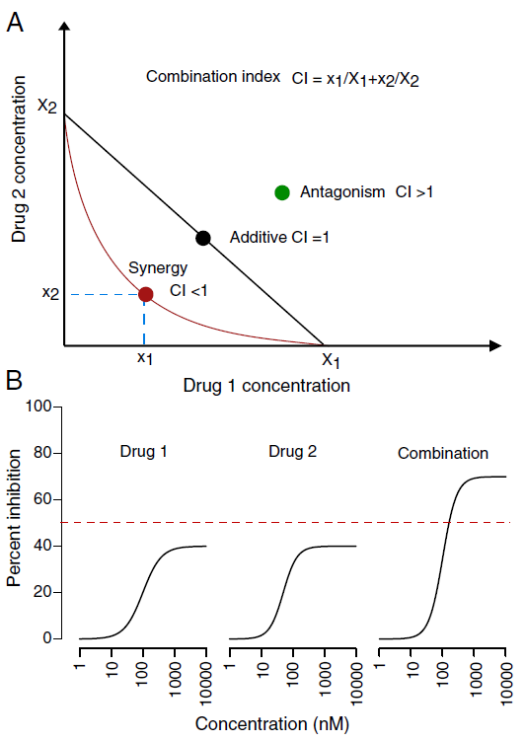
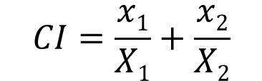
Loewe additivity model
Assumption on additive: a drug combined with itself
Limitation:
Do not apply when combinatory effect exceed the maximum effect of both drugs
dose of two drugs
$$CI=\frac{x1}{X1}+\frac{x2}{X2}$$
Drug 2 dose
same effect with only drug 1
same effect with only drug 2
Drug 1 dose
Yadav, Bhagwan, et al., 2015
Notes:
Loewe assume that when a drug combines with itself, it should be additive.
Here, x1 and x2 are the dose of drug 1 and 2 in the combination.
X1 is the dose need to achieve the same effect of combination but with only drug 1.
Combination index is calculated from this formula. If CI < 1…
This model is very easy to understand, but it also has limitations, it cannot be applied when …
E.g. here when the combinatory effect exceed the maximum effect of both…, we cannot find the X1 and X2 in their DRC, they don’t exist.
We can see that, there is no uniform definition of drug synergy , and different model can give different conclusion of synergy.

Slide 7
Why we want drug synergy?
Single agent dose not achieve good therapeutic effect in complex disease (like cancer)
lack of efficacy: various CDK inhibitors
toxicity: BCL-2 inhibitors in solid tumor
drug resistance: farnesyltransferase inhibitors
Multi-drug therapy could potential overcome these problems
better therapeutic effect
reduced drug toxicity
delayed drug resistance
Vogler, Meike. 2014.
Asghar, Uzma, et al. 2015.
Chapman, Paul B. 2013.
Notes:
Drug synergy is complicated, but why we want synergy?
The answer is simple, because single drug sometimes is not good enough, especially in complex disease like cancer.
There many promising drug candidates in preclinical research perform bad in clinical trials.
E.g. CDK show lack of efficacy in patients, BCL-2 has intolerable toxicity and resistance to farnesyltransferase inhibitors
Having these problems, people are turning to multi-drug therapy which can …

Slide 8
How drug synergy occur?
Pharmacokinetic synergy
one drug regulate the absorption, distribution, metabolism and excretion (ADME) of another drug
eg. Some drug reduces the motility of the small intestine, then it can inrease the absorption of many drugs in the small intestine
Pharmacodynamical synergy
two drug cooperate in their mechanism of action
eg. Cisplatin & irinotecan
Cisplatin intercalates DNA (this effect could be partially reduced by TOP I), irinotecan inhibit TOP I, thus could offset this activity.
Usually hard to see in cell level.
Notes:
Drug synergy is good, but how we study it, how do they happen?
There are two types of synergy, one is phar… synergy, which refer to when
E.g. ……, this could potentially lead to drug synergy. But, …
Another type, … means two drug cooperate
A possible mechanism of thie combination is …
Mechanism of drug synergy is very diverse, and largely unknown, this is just a possible speculation.

Slide 9
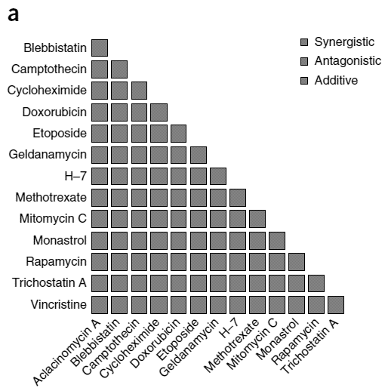
How to identify synergistic pairs?
Inference based on MOA
may work in some simple scenario: cocktails for AIDS
The mechanism of drug synergy is highly diverse, and largely unknown
Screening
in vivo screening
Cost issue: # of combination increase exponentially
in silico screening
identify promising hits
reduce the # of combination to validate
Notes:
Then we could ask how we could identify synergistic pairs.
Someone may say we can infer based on their MOA, it may …, but in general, inference on MOA would be very hard.
Another approach is high throughput screening. This is wildly used for single drug, but when it comes to multi-drugs, the # of possible combination will increase exponentially. Consider the potential profit we can have, many pharmaceutical company don’t think it’s valuable to conduct large scale screening.
So if we can use computational approach to first

Slide 10
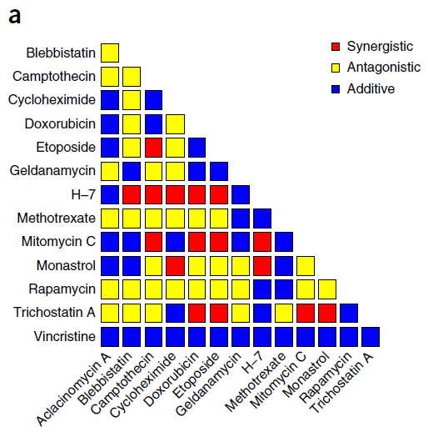
How to identify synergistic pairs?
Inference based on MOA
may work in some simple scenario: cocktails for AIDS
The mechanism of drug synergy is highly diverse, and largely unknown
Screening
in vivo screening
Cost issue: # of combination increase exponentially
in silico screening
identify promising hits
reduce the # of combination to validate
Bansal, Mukesh, et al. 2014.
Notes:
Then we could ask how we could identify synergistic pairs.
Someone may say we can infer based on their MOA, it may …, but in general, inference on MOA would be very hard.
Another approach is high throughput screening. This is wildly used for single drug, but when it comes to multi-drugs, the # of possible combination will increase exponentially. Consider the potential profit we can have, many pharmaceutical company don’t think it’s valuable to conduct large scale screening.
So if we can use computational approach to first

Slide 11
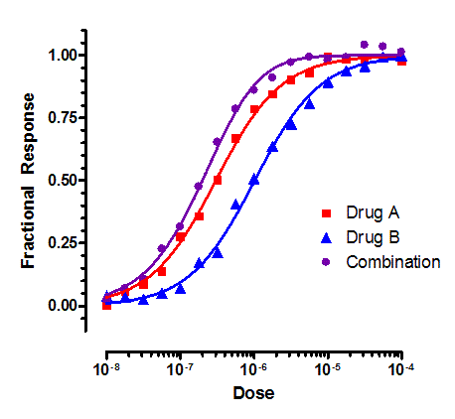
Computational approach
Traditional approach (dose effect curve)
kinetics based – median effect & mass action law
simple effect measure – protein inhibition
simple drug interaction – same target or same reaction
much simpler but not so valuable
In reality
indirect effect measure – cell death phenotype
complex drug interaction – gene regulatory network
Will –omic data be helpful to answer this question?
Notes:
Traditional computational approach is more dose-effect curve oriented. They are kinetics based, derived from …
They use simple effect …, assume simple drug interaction
By doing this simplification, we are able to study some simple synergy, but not …
In reality, what we are more interested is indirect effect
And usually, drug exert synergy through complex protein interaction network.
Now, with –omic data become much more available, we want ask …

Slide 12
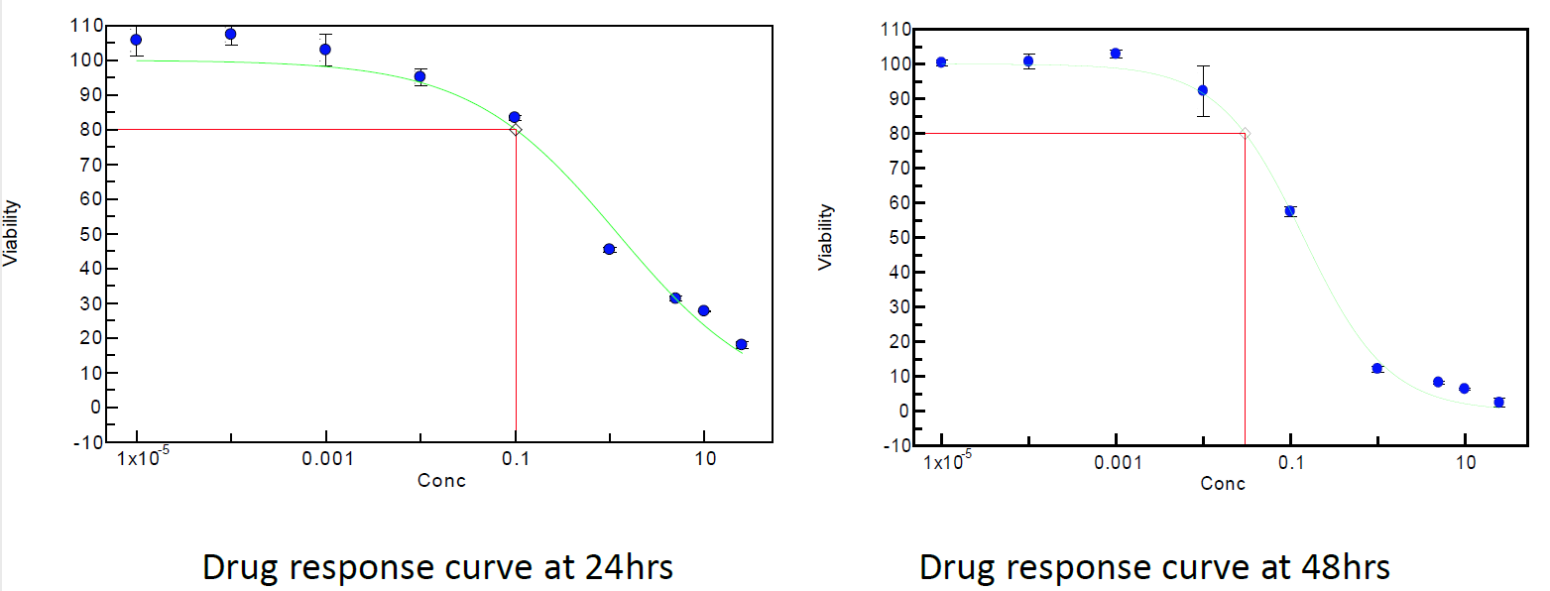
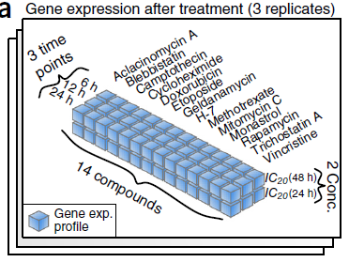
DREAM 7 drug synergy data set
gene expression data
predict the synergistic rank of all the compound pairs
dose response curve
24h DRC
48h DRC
Bansal, Mukesh, et al. 2014.
Notes:
2012, DREAM challenge launched a competition for drug synergy perdition.
This dataset contains 14 drugs, for each drug, GEP were measured in 6h, 12h and 24h after drug treatment. And drug was given in two dose …
DRC
With these data, participants were ask to rank all drug pairs from most synergistic to most antagonist.

Slide 13
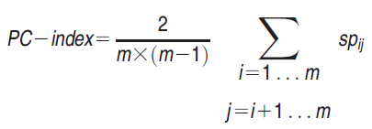
Performance evaluation
Scoring function – PC-index
Predicted
Ground truth
Combination | Predicted Rank | Observed Rank
Doxorubicin & H-7 | 21 | 1
H-7 & Mitomycin C | 3 | 2
Etoposide & Mitomycin C | 5 | 3
Doxorubicin & Mitomycin C | 11 | 4
Camptothecin & Mitomycin C | 7 | 5
Etoposide & H-7 | 9 | 6
Blebbistatin & H-7 | 8 | 7
… | … | …
Blebbistatin & Camptothecin | 42 | 88
Camptothecin & Rapamycin | 28 | 89
Etoposide & Monastrol | 45 | 90
Doxorubicin & Monastrol | 49 | 91
Random guess has PC-index 0.5.
Maximum PC-index is 0.9 because of the noise of the dataset.

Slide 14
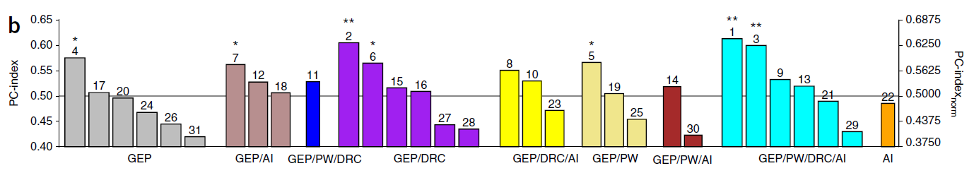
Drug Induced Genomic Residual effect (DIGRE)
DIGRE
PC-index 0.613
p-value < 0.0001

Slide 15
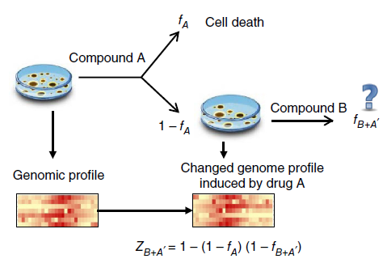
Assumption: sequential drug addition
Approximate drug combination by sequential drug addition
Available data
Need to estimate
Question:
What is the viability reduction of drug B treatment? (drug A has been given first)
Assumption 1:
The genomic change induced by drug A reflect the killing effect of drug A.
Assumption 2:
The genomic change induced by drug A can contribute to the killing effect of drug B.
Question: how to quantify this contribution
Notes:
How DIGRE work?
Because what we have is the single drug treatment data, so we approximate …
Then the question becomes how to estimate the viability reduction if the cell has already been treat …
We have the gene expression profile in baseline and single drug treatment, to use these data, we assume that …
And further we assume that …
Now the question becomes how to quantify the contribution of first drug to the second drug.

Slide 16
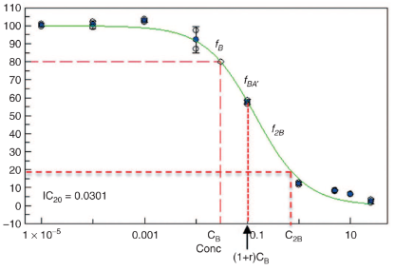
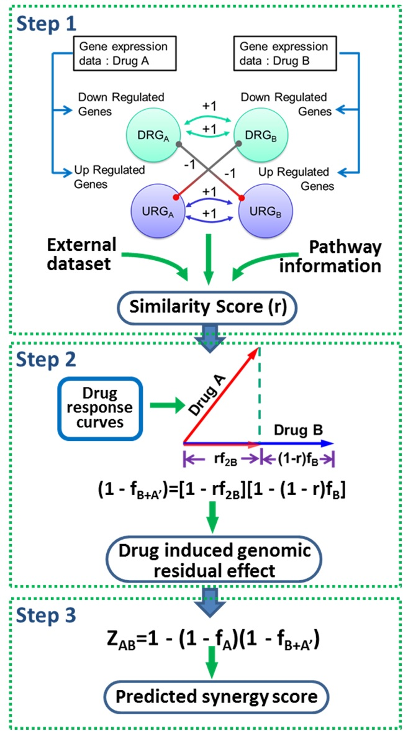
How to quantify the contribution of drug A?
Two extreme case:
Drug A has no contribution to drug B
Drug A is same as drug B
Some where in between
No contribution
1 - f_{B+A’} = 1 - f_{B}
1 - f_{B+A’} = 1 – f_{2B}
Same drug
We proposed a similarity score r to estimate the middle phase.
Notes:
To quantify this, we first exam two extreme case: first, if drug A has no contribution to drug B, in that case, A + B equal B, so we can read the effect of combination of the DRC of B
Second, if the drug A is same as drug B, then the combination is 2B, we can also read the effect from dose response curve.
To estimate the middle phase, we propose this formula. R is the similarity score to of two drugs to give different weight to these two case.

Slide 17
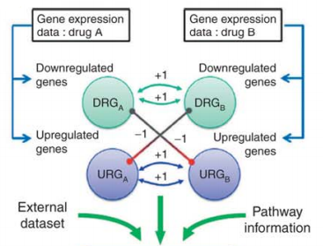
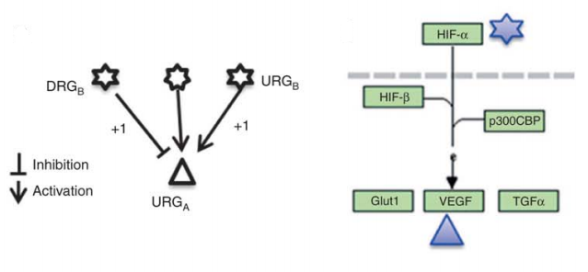
How to compare drug similarity?
Compare the genomic change in 8 cell growth related KEGG pathway (focused view)
Look at the up-stream genes (global view)
aminoacyl-tRNA biosynthesis
MAPK signaling pathway
NF-kappa B signaling pathway
Cell Cycle
p53 signaling pathway
Apoptosis
TGF-beta signaling pathway
Cancer pathway
Similarity score (r)
Notes:
The detail to calculate r is a little complicated and tedious, I’m going to skip this part, the concept is more similar the gene expression profile of this two drug, the bigger the r.

Slide 18
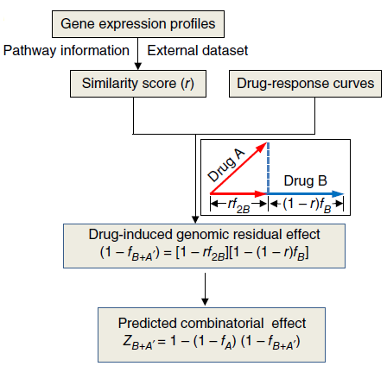
DIGRE workflow and performance
DIGRE workflow
PC-index 0.613
Top rank pairs
Combination | DIGRE Rank | Observed Rank
H-7 & Rapamycin | 1 | 27
H-7 & Monastrol | 2 | 14
H-7 & Mitomycin C | 3 | 2
H-7 & Trichostatin A | 4 | 19
Etoposide & Mitomycin C | 5 | 3
Methotrexate & Mitomycin C | 6 | 28
Camptothecin & Mitomycin C | 7 | 5
Blebbistatin & H-7 | 8 | 7
Etoposide & H-7 | 9 | 6
Camptothecin & Methotrexate | 10 | 62
Doxorubicin & Mitomycin C | 11 | 4
Camptothecin & H-7 | 12 | 10
H-7 & Vincristine | 13 | 43
Camptothecin & Etoposide | 14 | 15
Etoposide & Methotrexate | 15 | 76
Notes:
1. This the top predicted pairs and their real rank. We can see most top rank are validated synergistic pairs.

Slide 19
Model improvement
Construct content-specific gene network using co-expression data
GSE10846 expression data (DLBCL: diffuse large B-cell lymphoma)
414 samples and 54,614 probes (21,050 genes)
Future plan
Link genomic change with cell growth phenotype
(CRISPRi and CRISPRa screening)
Method | PC-Index
Original KEGG pathway | 0.614
Marginal correlation network | 0.626
Partial correlation network | 0.627
Notes:
As we can see though DIGRE is the best performed model, its PC-index is not very high. We want to further improve it.
One key component in the model is the gene-gene interaction information, before we use the KEGG pathway information. KEGG is empirical collected database, it’s not complete and not content-specific.
Because the DREAM data is generated in B-cell lymphoma cell line, so we wonder if we can improve the model by constructing content-specific gene network using co-expression data.
We used both marginal and partial correlation algorithm to … as we expected, the PC-index increased. Though not very impressive, but at least, it confirms that the gene regulatory network do plays a role in drug synergy.
Another thing I can think about is we need better knowledge to link the genomic change to cell growth phenotype. CRISPR screening is a potential resource we can use. Because it’s a direct measure of contribution of each gene to the cell growth.

Slide 20
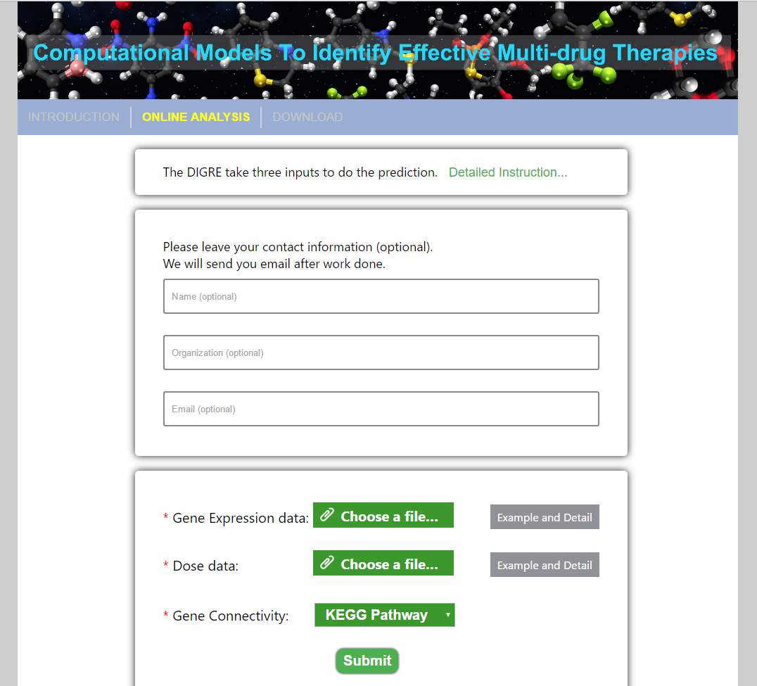
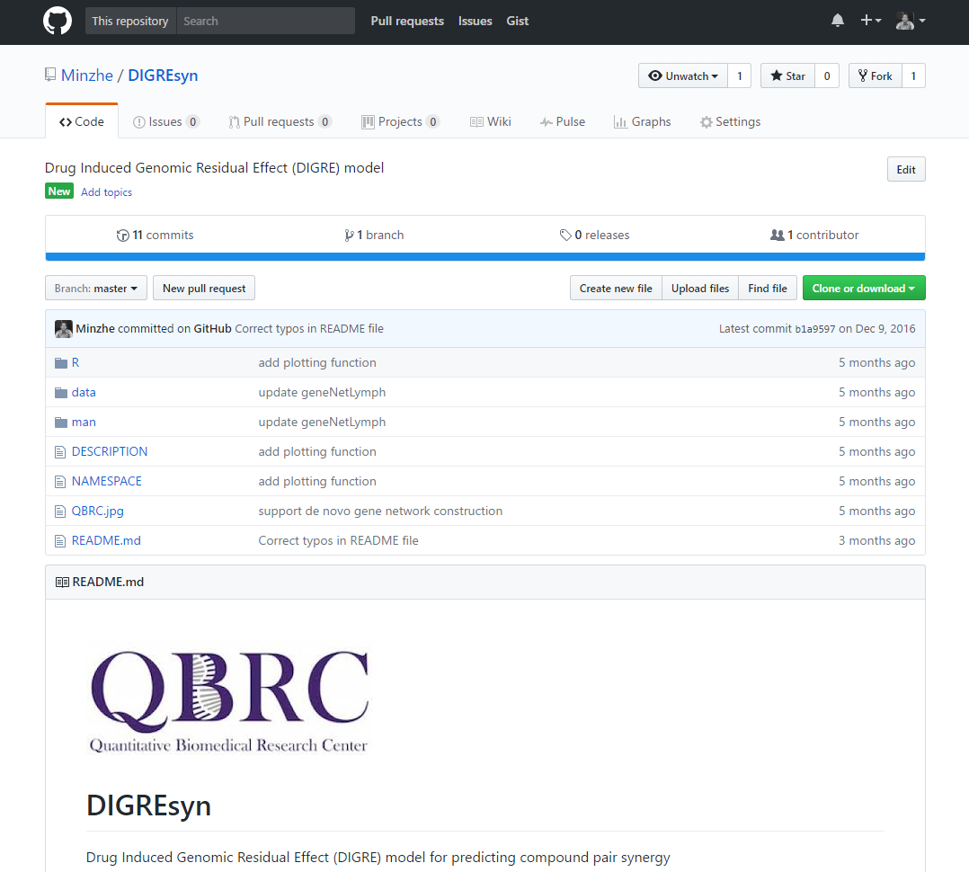
Implementation
Web application
https://qbrc2.swmed.edu/drugcombination/
R package
https://github.com/Minzhe/DIGREsyn

Slide 21
Biological Validation
Selected 33 compounds for dose response curve and transcriptome data.
9 FDA approved, 13 in clinical trials (6 in phase III, 6 in phase II, 1 in phase I) and 11 in preclinical research.
Compound | Target | Pathway | Compound | Target | Pathway
Pemetrexed | DHFR | Cytotoxic Drugs | RO-3306 | CDK1/2 | Cell Cycle
Cisplatin | DNA |  | VX-680 (Tozasertib, MK-0457) | AURK
Paclitaxel | Microtubule |  | MK-8776 (SCH 900776) | CHK1 | DNA Damage & Repair
Irinotecan | TOP I |  | VE-821 | ATR
Etoposide | TOP II |  | NU7441 | DNAPK
Erlotinib | EGFR | Membrane Receptor Kinase | Olaparib | PARP
Linsitinib (OSI-906) | IGFR |  | ABT-263 | BCL-2, BCL-XL | Apoptosis
AZD4547 | FGFR |  | Birinapant | IAP
Crizotinib | ALK |  | Bortezomib | Protesome | Ubiquitin/Proteasome
Pictilisib(GDC-0941) | PI3K | PI3K-AKT-mTOR pathway | Entinostat | HDAC | Epigenetic Modification
MK-2206 2HCl | AKT |  | EX-527 | SIRT1
AZD8055 | mTOR |  | STA-9090 | HSP90 | Cytoskeletal Signaling
PF-562271 | FAK | Angiogenesis | FDI-6 | FOXM1 | Transcription Factor
FTI 277 HCl | FNTA | MAPK pathway | Troglitazone | PPAR-γ | Nuclear Hormone Receptor
TAK-632 | B-RAF |  | T0901317 | LXR
Selumetinib(AZD6244) | MEK |  | GSK2194069 | FASN | Fatty Acid Metabolism
 |  |  | Indisulam | RBM93 | Splicing factor

Slide 22
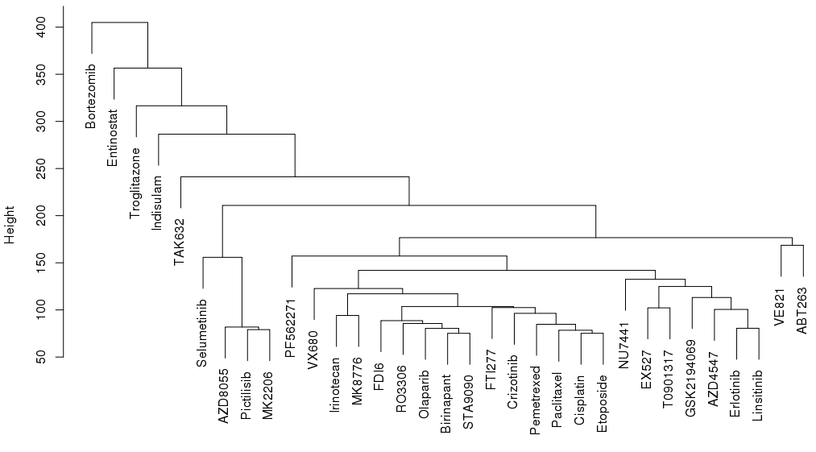
Gene expression profile clustering
PI3K/Akt/mTOR pathway inhibitors
receptor tyrosine kinase inhibitors
cytotoxic drugs

Slide 23
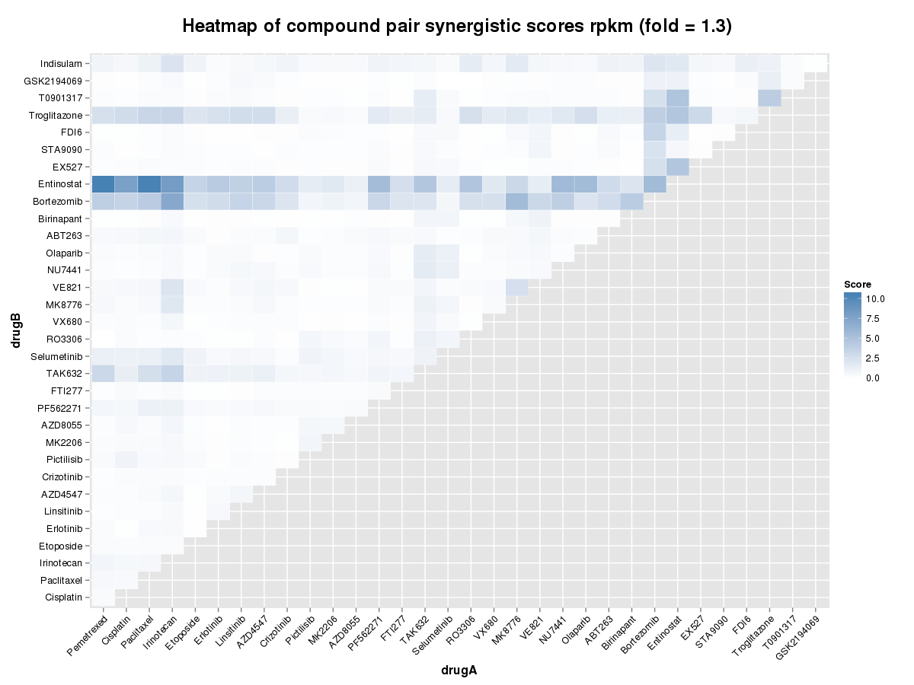
DIGRE analysis

Slide 24
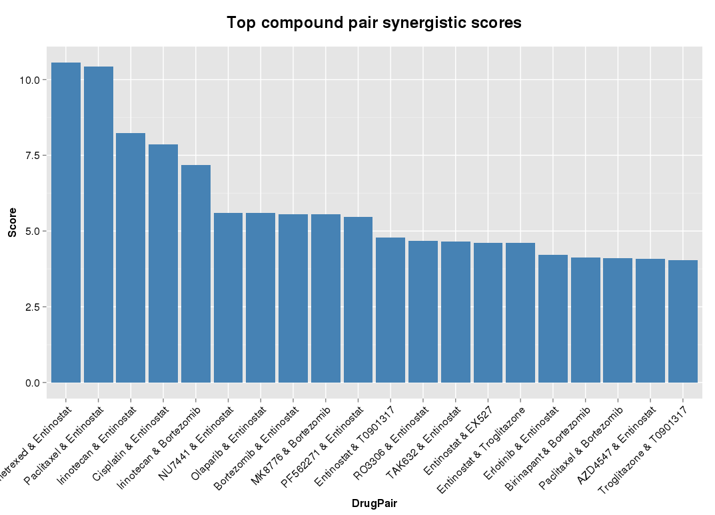
Top ranked pairs

Slide 25
Future plan
Validate in NCI ALMANAC dataset
NCI ALMANAC (A Large Matrix of Antineoplastic Agent Combinations)
Over 100 small molecule oncology drugs FDA-approved.
Test all possible pairwise combinations of these ~5000
Test each drug pair in each of the cell lines in the NCI-60 panel.
To be public
Biological validation
Collaborate with biologist to pick top ranked pairs with good rationale and possible novel mechanism for further validation.

Slide 26
Outline
Computational Approach to Predict Multi-Drug Synergistic Effect
Background
IGRE model
Biological validation
Summary and future plan
Bioinformatics Tool to Detect RBP Bound CircRNA in CLIP-Seq Datasets
Background
Motivation
Pipeline
Preliminary results
Future plan

Slide 27
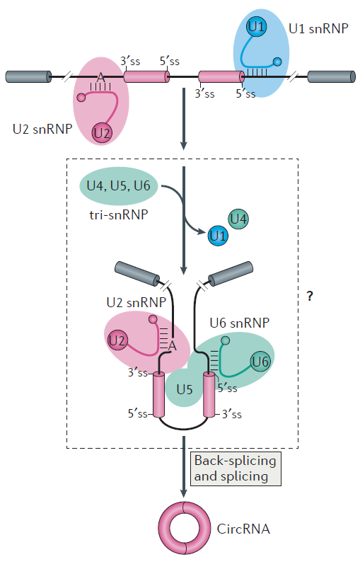
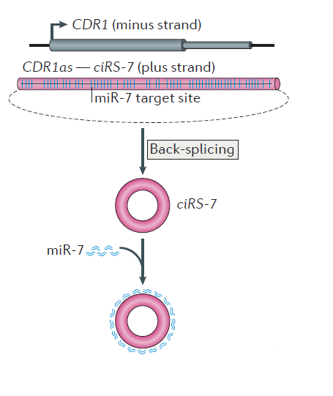
CircRNA
Formation
Back-splicing circularization, downstream 3’ splice site and upstream 5’ splice site is joined
Function
ciRS-7 serves as miRNA sponges

Slide 28
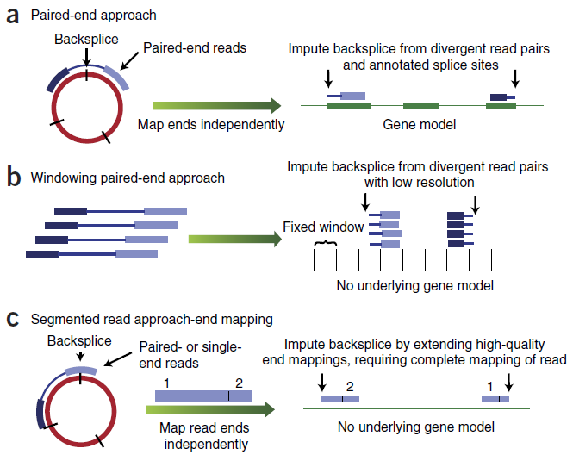
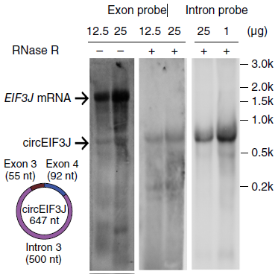
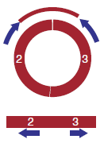
CircRNA detection
Sequencing based methods
Biochemical methods
Impute backsplice from divergent reads
(pair-ends)
Impute backsplice from single reads mapped to two ends
(single or pair ends)
Divergent qPCR primer
RNase R digestion

Slide 29
Motivation
Functionally important to know the RBP-circRNA interaction
Large scale profiling of RBP-circRNA interaction using CLIP-Seq data
Current algorithm to detect circRNA
all focused on RNA-Seq, cannot be directly applied to CLIP-Seq data
CLIP-Seq has shorter length reads compared to RNA-Seq
CLIP-Seq data is exclusively single-end
CLIP-Seq data has limited library complexity
Goal: To develop an pipeline to profile circRNA in CLIP-Seq data
Tool | Language | Aligner | Ref
Mapsplice | Python | Bowtie1 | Wang et al., 2010
find_circ | Python | Bowtie2 | Memczak et al., 2013
circRNA_finder | Perl | STAR | Westholm et al, 2014
CIRCexplorer | Python | Bowtie1 and 2 | Zhang et al, 2014
CIRI | Perl | Bwa | Gao et al, 2015

Slide 30
Workflow
Download public CLIP-Seq datasets
Build alignment library
Collect identified circRNA
CLIP-Seq reads
Linear transcript
Linearization of circRNA sequence
Removing PCR duplicates
Build alignment library from combined genome
Competitive alignment
Alignment to circRNA
Alignment to linear transcript

Slide 31
Competitive alignment
CLIP-Seq reads
Mapped to linear transcript
Mapped to linearized circRNA
Mapped to non-junction part
Mapped to across junction
Filtering rules
The overhangs from the junction too short?
Too many mismatches in either overhang?
Pass both
Fail either one
Alignment to linear transcript
Valid alignments to circRNA
Not a valid alignment

Slide 32
Filtering
To reduce false positive discovery, only keep circRNA:
that have ≥ 2 CLIP-Seq reads mapped across junction.
with at least 20 nucleotides covered at one junction–spanning reads.
with number of unique mapping start position and end position greater than 1/3 of the total number of reads mapped across this junction.

Slide 33
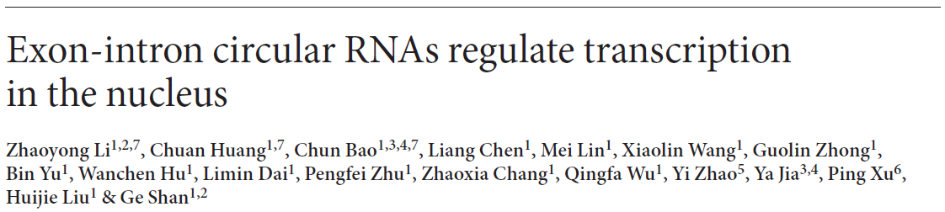
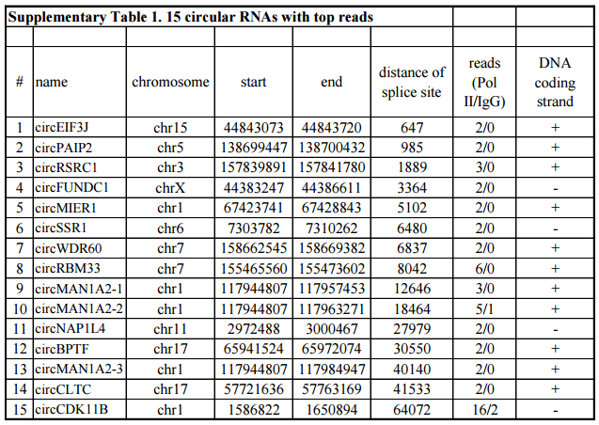
Preliminary validation
circRNA name | Chromosome | Start | End | Strand | # supporting reads
circEIF3J | chr15 | 44843074 | 44843720 | + | 2
circPAIP2 | chr5 | 138699448 | 138700432 | + | 2
circRSRC1 | chr3 | 157839892 | 157841780 | + | 3
circFUNDC1 | chrX | 44383248 | 44386611 | - | 3
circMIER1 | chr1 | 67423742 | 67428843 | + | 3
circSSR1 | chr6 | 7303783 | 7310262 | - | 2
circWDR60 | chr7 | 158662546 | 158669382 | + | 3
circRBM33 | chr7 | 155465561 | 155473602 | + | 12
circMAN1A2-1 | chr1 | 117944808 | 117957453 | + | 2
circMAN1A2-2 | chr1 | 117944808 | 117963271 | + | 9
circNAP1L4 | chr11 | 2972489 | 3000467 | - | 4
circBPTF | chr17 | 65941525 | 65972074 | + | 2
circMAN1A2-3 | chr1 | 117944808 | 117984947 | + | 2
circCLTC | chr17 | 57721637 | 57763169 | + | 0
circCDK11B | chr1 | 1586823 | 1650894 | - | 49
15 experimentally validated circRNA bound by Pol II
Our pipeline re-identified 14 of these 15 circRNA

Slide 34
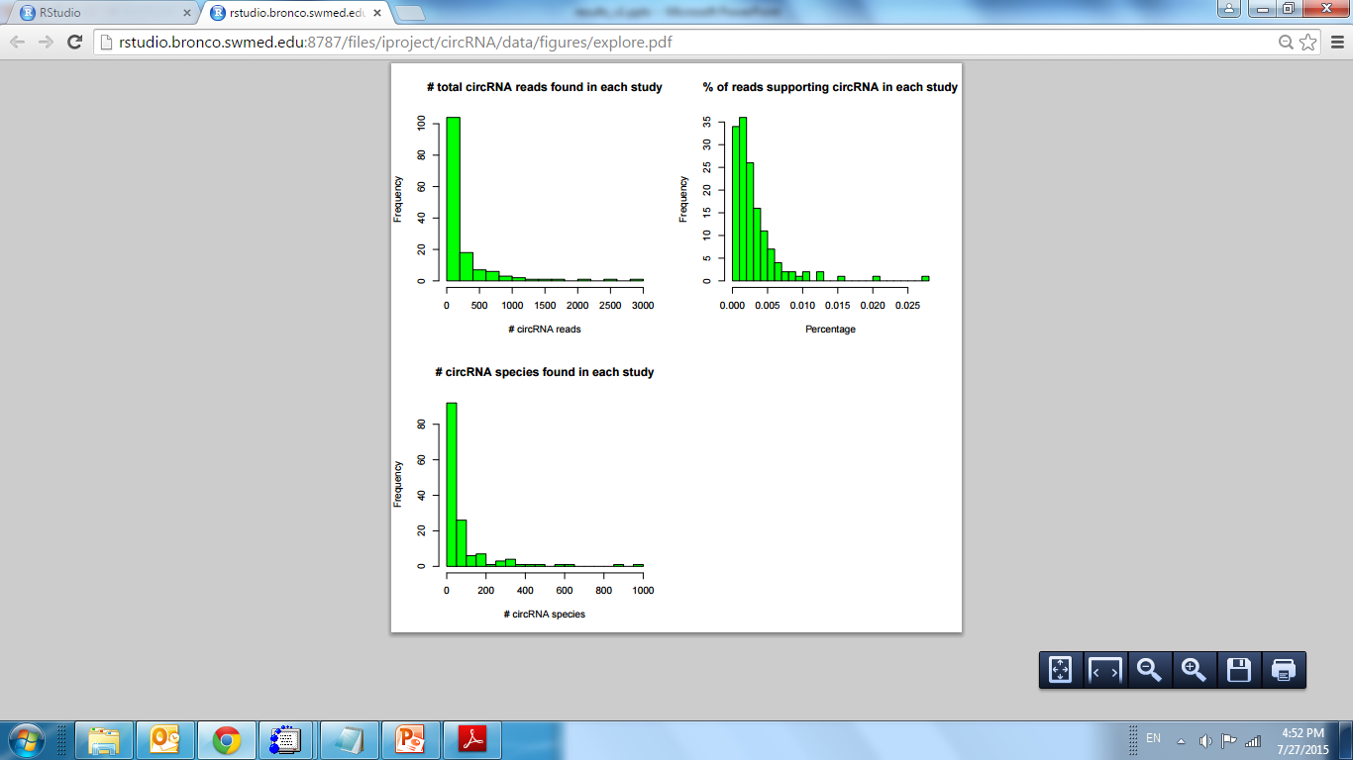
Summary statistics
Percentage of circRNA supporting reads in CLIP-Seq similar to RNA-Seq

Slide 35
Future plan
Conduct motif search to determine if RBPs bind to circRNA through specific sequence motif recognition
Cluster RBPs based on the similarity of circRNA they binds to find if clustered RBPs share some similar properties.
Functional study to see if the parental genes for circRNA bound by each RBPs are enriched in some certain biological process.

Slide 36
Acknowledgement
Quantitative and Biomedical Research Center
Dr. Yang Xie
Dr. Guanghua Xiao
Dr. Tao Wang
Dr. Sangin Lee (previous)
Dr. Bo Yao
Dr. Yiwei Liu (previous)
Deepak Nijhawan’s lab
Dr. Deepak Nijhawan
Dr. Ting Han
Maria Goralski
John Minna’s lab
Dr. John Minna
Dr. Michael Peyton
High Throughput Screening Core
Dr. Bruce Posner
Melissa McCoy
Genomic and Microarray Core
Dr. Ward Wakeland
Dr. Quan-Zhen Li
Chaoying Liang
George Adam

